Slide 1




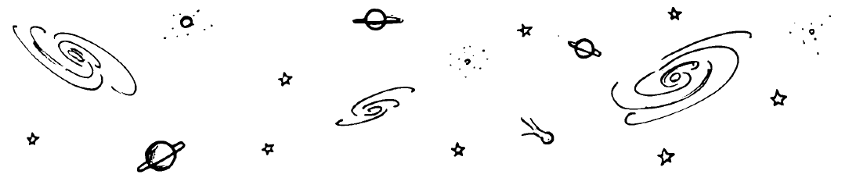
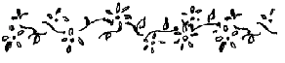



Slide 2




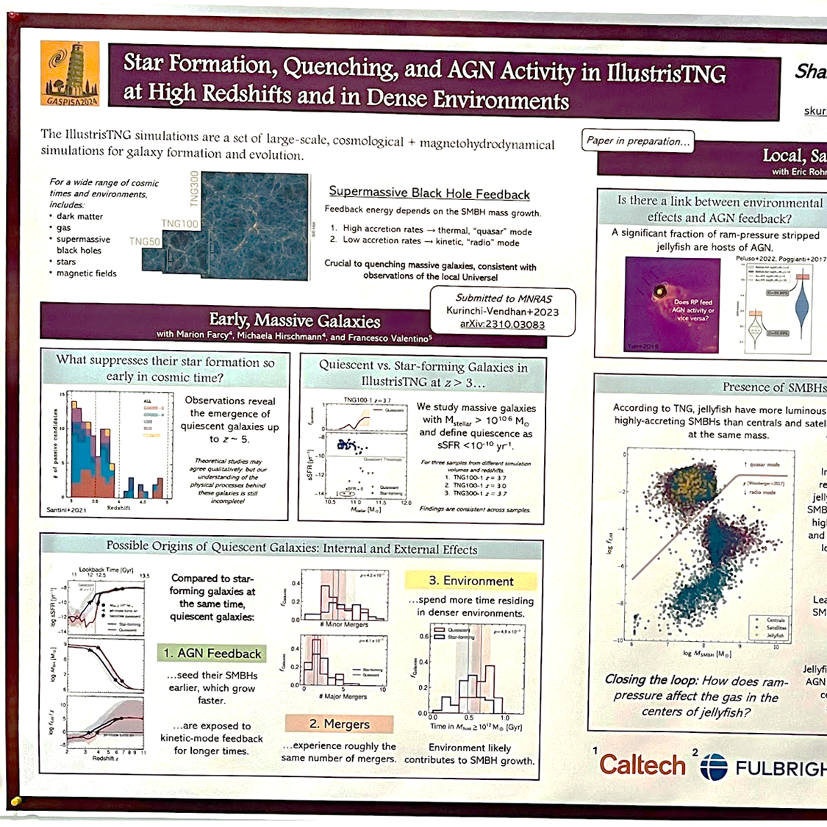



Slide 3
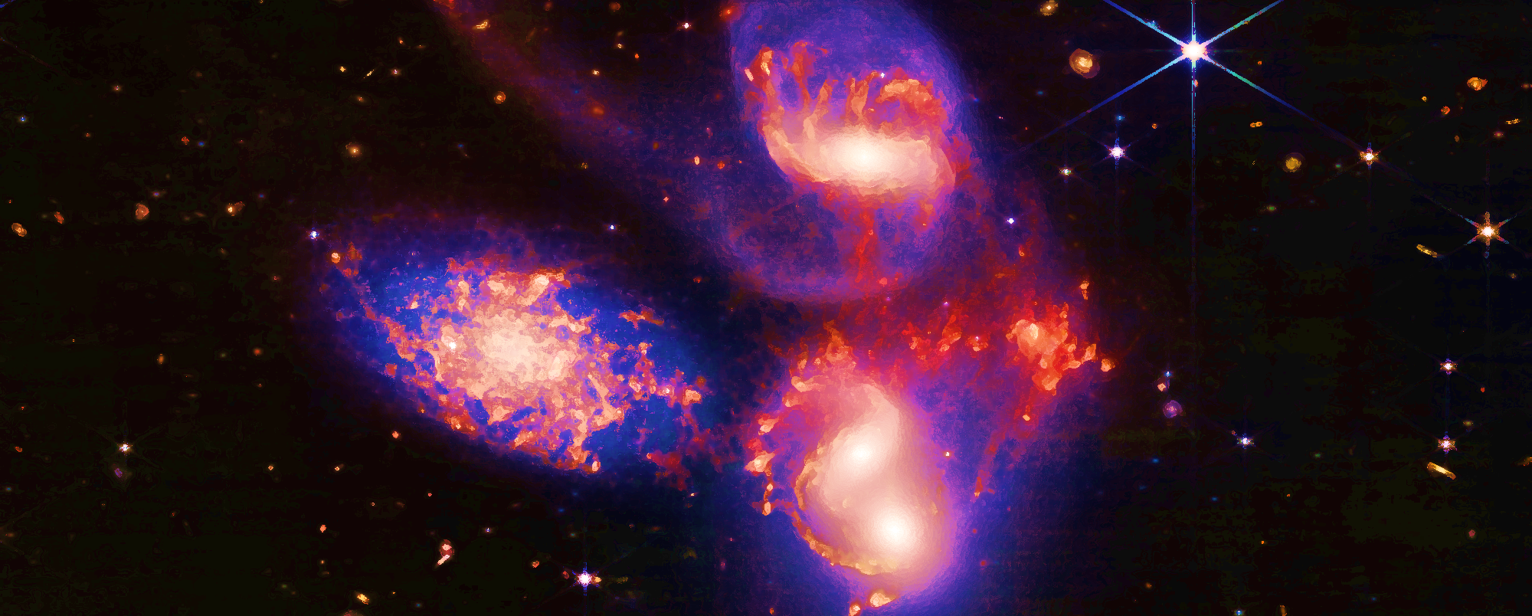

Slide 4


Slide 7
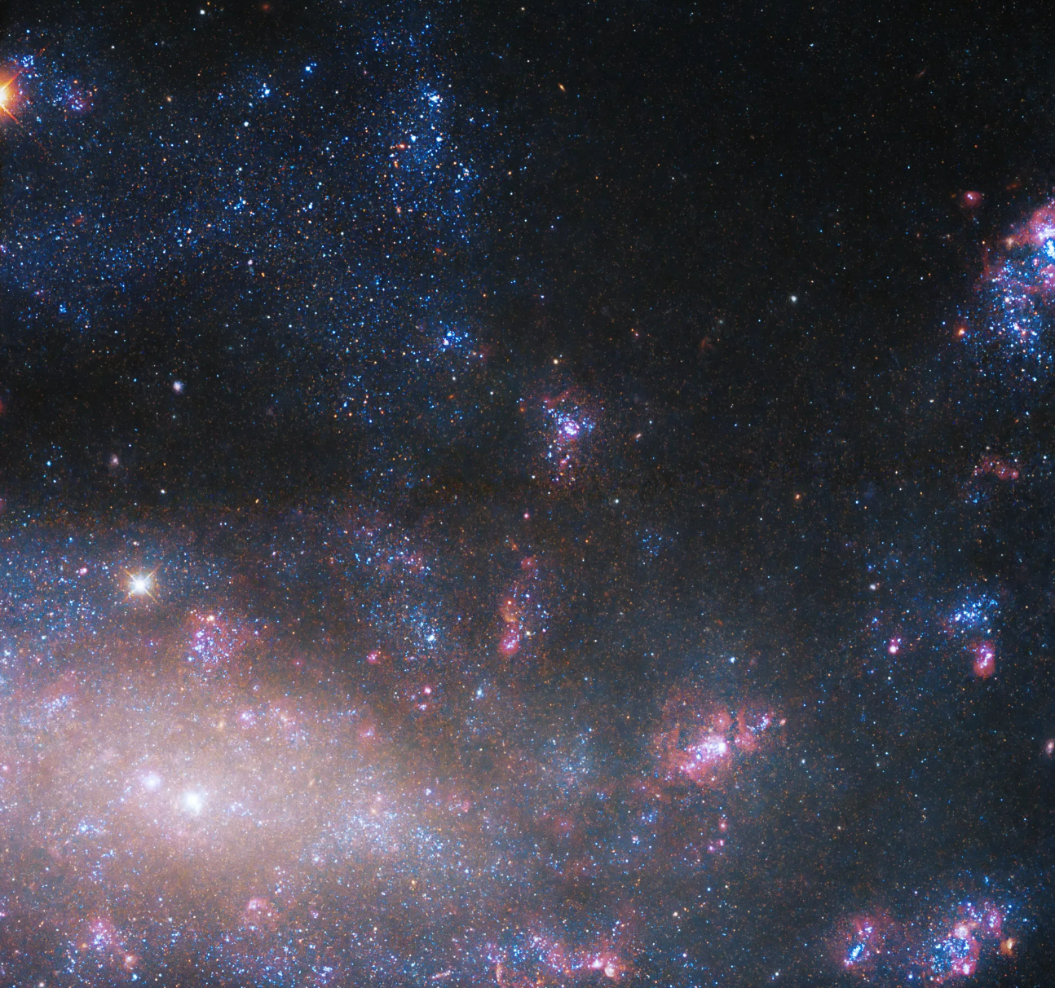

NGC 4395 (NASA/ESA Hubble)
Do dwarf galaxies have AGN?
Is star formation suppressed?
… Is there a connection?

Slide 8
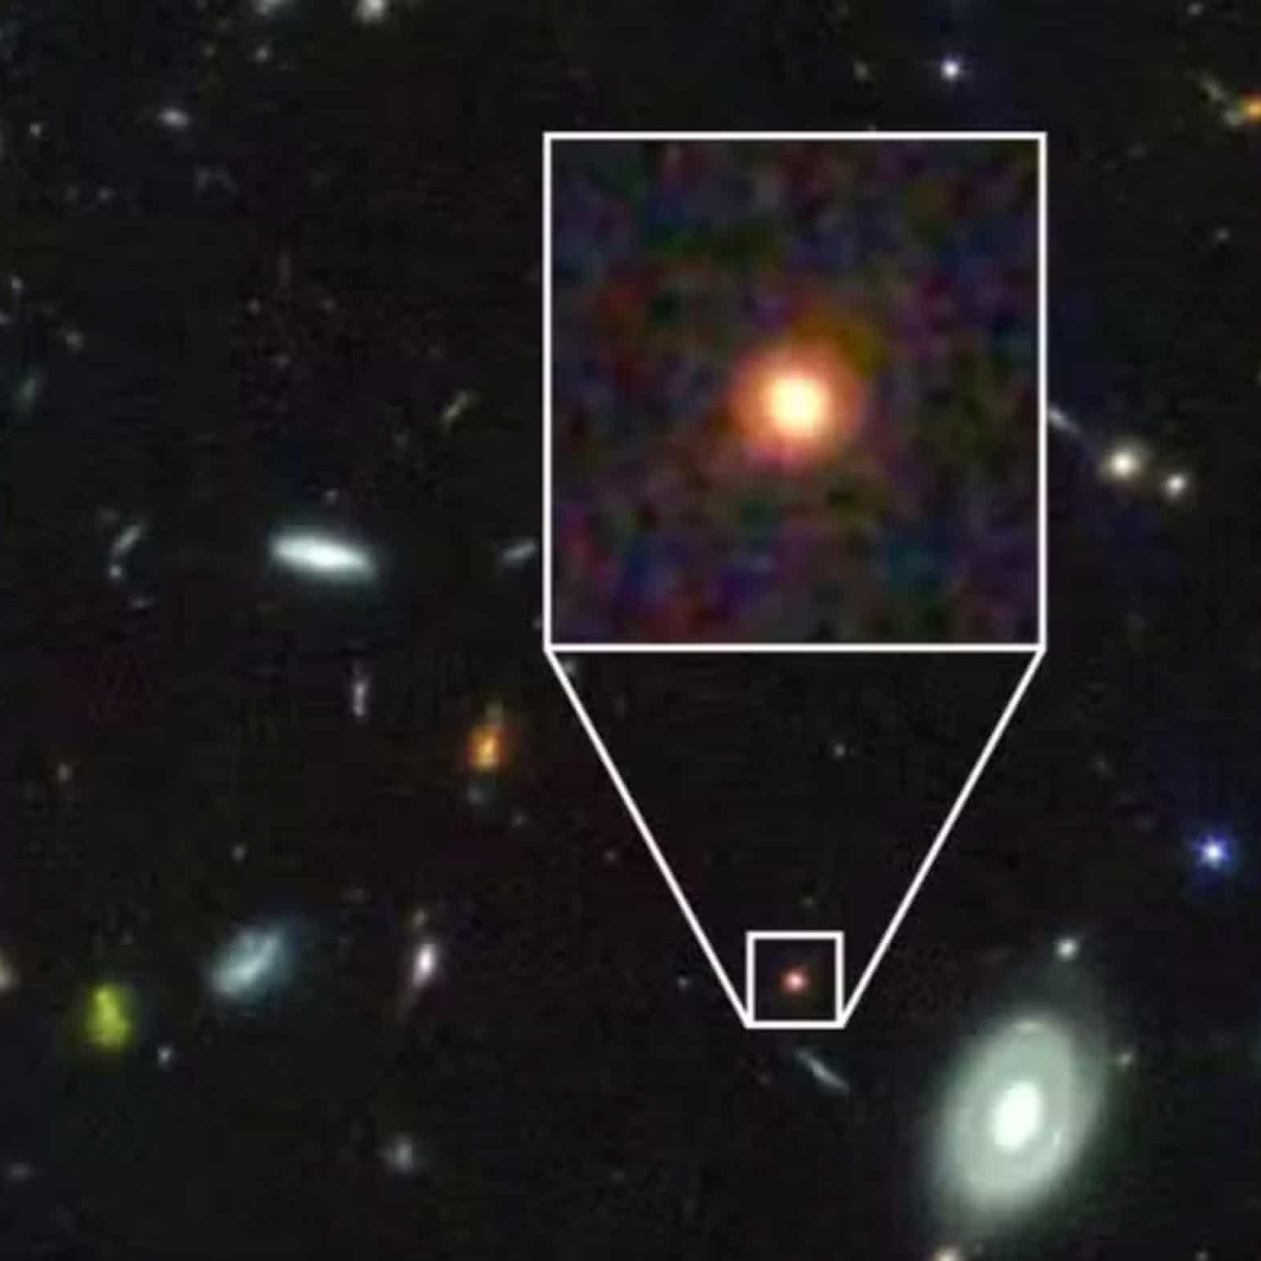


GS-9209 (JWST)
Why did some galaxies
stop forming stars
so early in
cosmic time?
AGN Feedback
Mergers
Large-scale environment
!

Slide 9
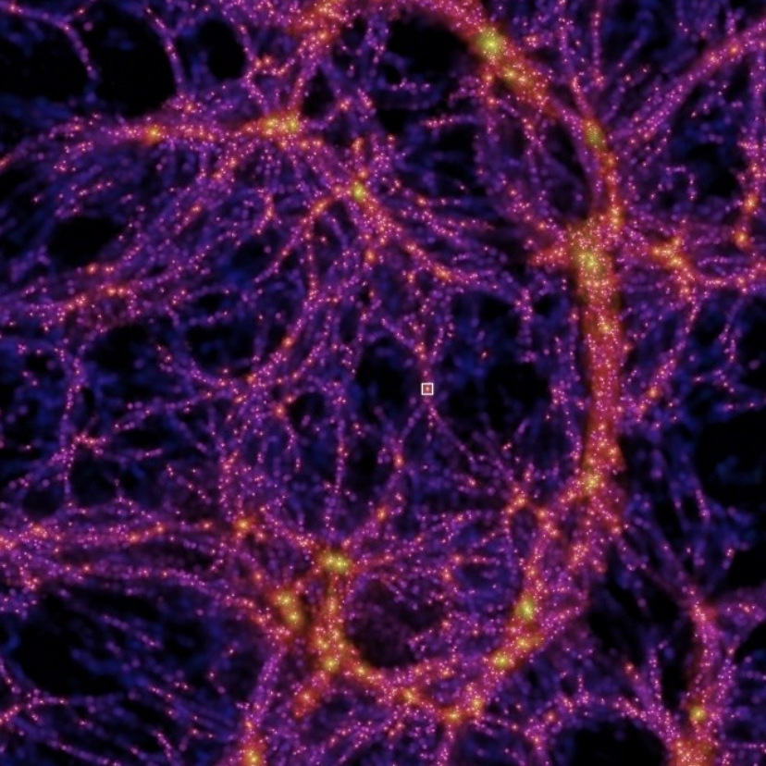
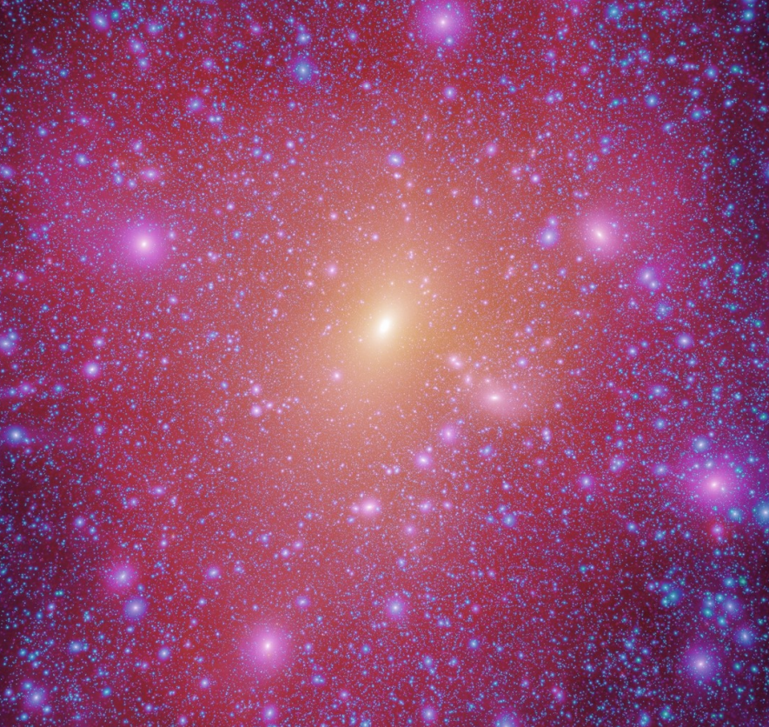
Millenium Simulation
Are there small-scale problems
in the ΛCDM model?

Slide 10



Slide 11



